Slide 1
The Louisiana Purchase
By Loz McKenzie

Slide 2
Overview
What was the Louisiana Purchase?
How did the Louisiana Purchase Start?
How much did the Louisiana Purchase cost?
Importance
On what date did the Louisiana Purchase begin?
How did the Louisiana Purchase change the U.S?
How were negotiations?
Why did Federalists oppose the Louisiana Purchase and what was their plan?
What were the issues on the purchase of the Louisiana territory?
How did the Lewis and Clark Expedition impact westward expansion?
How did the Louisiana Purchase impact Native Americans in that region?
Important People

Slide 3
Background
Thomas Jefferson wants the New Orleans port and West Florida to expand trade, so he sends James Monroe and Robert Livingston to purchase the land.
Napoleon is in a war with England and he needs the extra cash, so he gives up the Louisiana Territory for an additional 5 million
Jefferson gets more land than he instructed Monroe and Livingston to buy.

Slide 4
What was the Louisiana Purchase?
The Louisiana Purchase was a transaction between the U.S and France in April 30, 1803 purchasing 828,000 square miles for 4 cents per acre.
The U.S doubled its size with the purchase of the Louisiana Territory
It is made up of the Treaty of Cession and two other accords focussing on the finance in the agreement.

Slide 5
How did the Louisiana Purchase Start?
It started when Jefferson needed to expand his trading area so he sent James Monroe and Robert Livingston to purchase Floridas and the New Orleans Port.
Napoleon is in desperate need of money after failing to stop the slave revolt in Haiti and a war with England.

Slide 6

How much did the Louisiana Purchase cost?
Monroe and Livingston offer 10 million dollars for the New Orleans Port and the Floridas.
Napoleon is trying to stop a Slave Revolt in Haiti and fight the British
Napoleon gives Jefferson’s men the Louisiana territory for an add on of 5 million dollars.
4 cents an acre
1 Acre = 43560
530,000,000 acres of land in total
10 Million + 5 Million = 15 Million
340 Million in today's money

Slide 7
Importance

Slide 8

Answer to said question.
The importance was the Louisiana Territory doubled its size making the country stronger. It also allowed to expand westward, gather resources and increased a large debacle/conflict between America and the Native Americans.

Slide 9
On What date did the Louisiana Purchase begin?
The Louisiana Purchase began on July 4th, 1803. One year later it was Disestablished On October 1, 1804.

Slide 10

How did the Louisiana Purchase Change the United States?
The Louisiana Purchase doubled in size allowing new expansion in the west, more power, move strength, more resources, better places to live and people going to the west to survive out in the wild.
Gave people the opportunity to take advantage of the Louisiana Territory and start taking large portions of land for themselves.

Slide 11
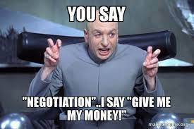
How were negotiations?
Negotiations were really quick with Napoleon needing the money desperately.
The representatives of the U.S. agree to pay France $11,250,000 and the other $3,750,000 for the Americans trapped in France.
In exchange for 15,000,000 handed over to France the U.S gets the Louisiana territory.

Slide 12

Why did Federalists oppose the Louisiana Purchase and what was their plan?
Federalists felt like if the purchase went threw with this there would be a huge power shift towards Thomas Jefferson and the Republicans.
Jefferson also saw the purchase as an opportunity to make an agrarian economy built on how much land you own.
The Federalists were “representing the interests of the East-Coast trade and Banking establishment.
Some of the federalists in New England threatened to secede
This didn't phase anyone and with a vote in congress the federalists lost 26 - 6 on votes

Slide 13

What were the issues on the purchase of the Louisiana territory?
Native Americans
Federalists worrying that the addition of slaves would politically balance the power of slaves and people
Increased number of Slaves
Thomas Jefferson denied some of the Louisiana Purchase because it went against the strict construction of the constitution so he had to advocate for it. Jefferson couldn't find authorization for it.
Supervise Americans on getting land because people were just taking massive amounts of land and stealing it for themselves. Also it was unfair.

Slide 14
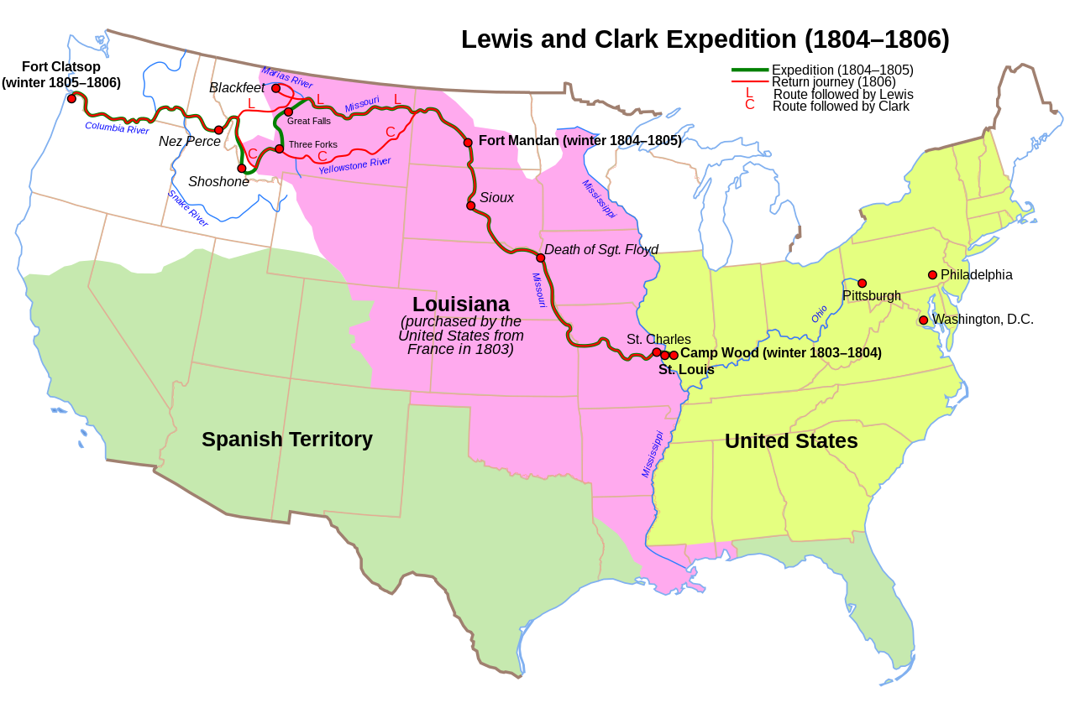
How did the Lewis and Clark Expedition impact westward expansion?
In 1804, one of the first things Jefferson did when he had the Louisiana Territory was to send Lewis and Clark off an expedition.
Jefferson needed them to explore west of the Mississippi River
Lewis and Clark during their journey further expanding their knowledge of plants and animals.
This expedition encouraged U.S. Citizens to explore into the Westward Expansion
Lewis and Clark provided detailed information about nature and the geography of the Louisiana Territory.

Slide 15
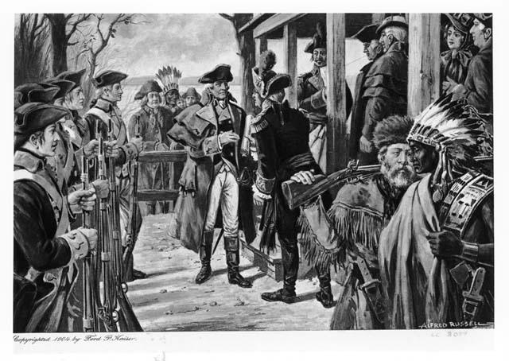
How did the Louisiana Purchase impact Native Americans in that region?
The Native Americans were forced to leave to reservations, losing their tribal lands.
The U.S. Government tried to force the natives to forget and leave behind their culture and religion.
The natives were paying the price for the westward expansion.
New diseases were brought by the U.S. and by the 1840 more than 5,000 people died on the Trail of Tears.

Slide 16
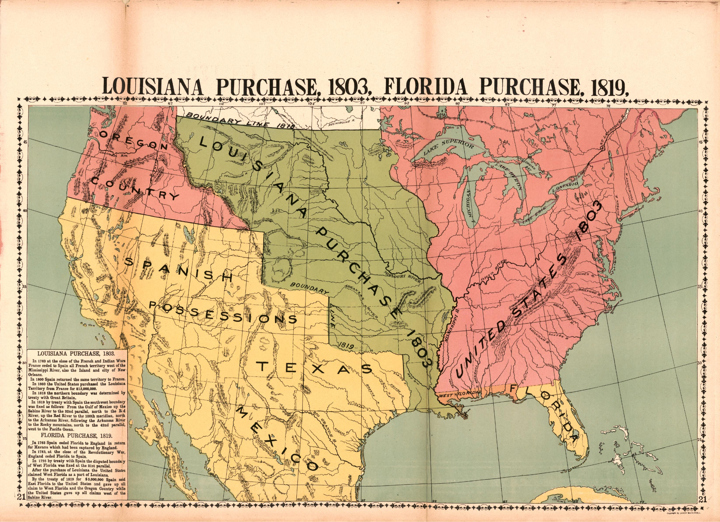
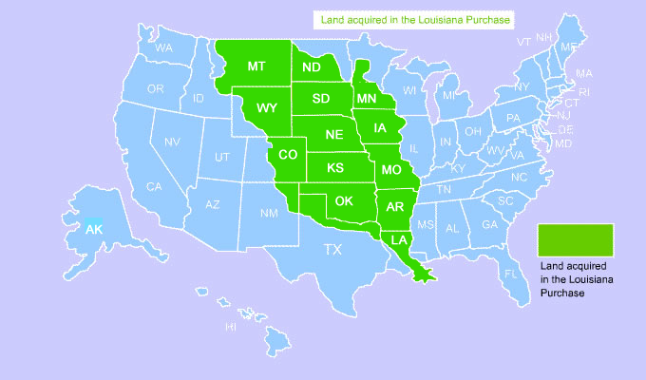
Map
We gained Louisiana, Arkansas, Missouri, Iowa, Oklahoma, Kansas, Nebraska, North Dakota, South Dakota, and parts of Minnesota, New Mexico, Montana, Wyoming, and Colorado.
Ignore Oregon. Spain, Great Britain, Russia and the U.S claimed it. In 1819 under the terms of the Transcontinental Treaty, Spain gave the U.S their part of Oregon. Over the years we had one major conflict with Britain in 1846 they don't want to go to war with us so they sign another treaty. In 1859 we finally get Oregon all to ourselves.

Slide 17
Important People to Note
Thomas Jefferson
Meriwether Lewis
William Clark
Robert Livingston
Napoleon Bonaparte
James Monroe

Slide 18
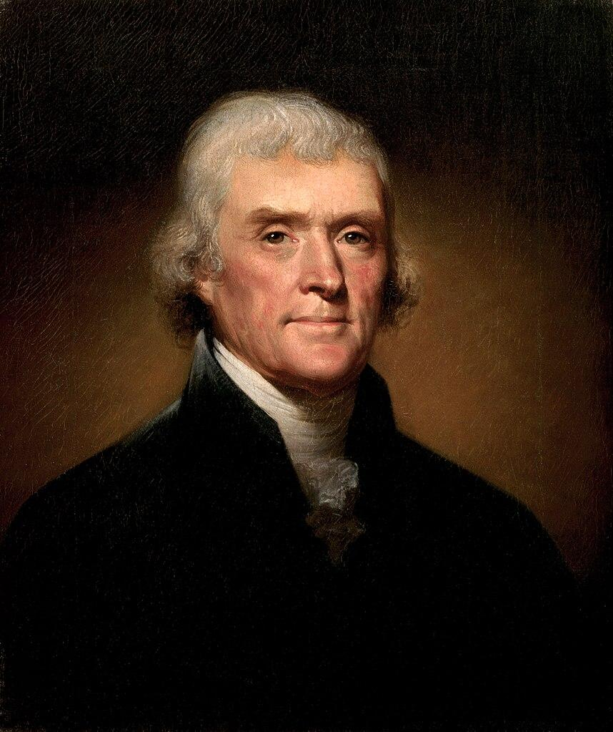
Thomas Jefferson
Thomas Jefferson
Born April 13, 1743
One of the most important people in the Louisiana Purchase.
3rd President of the United States
Approved of the Louisiana Purchase
Caused Lewis and Clark to go on an expedition.

Slide 19
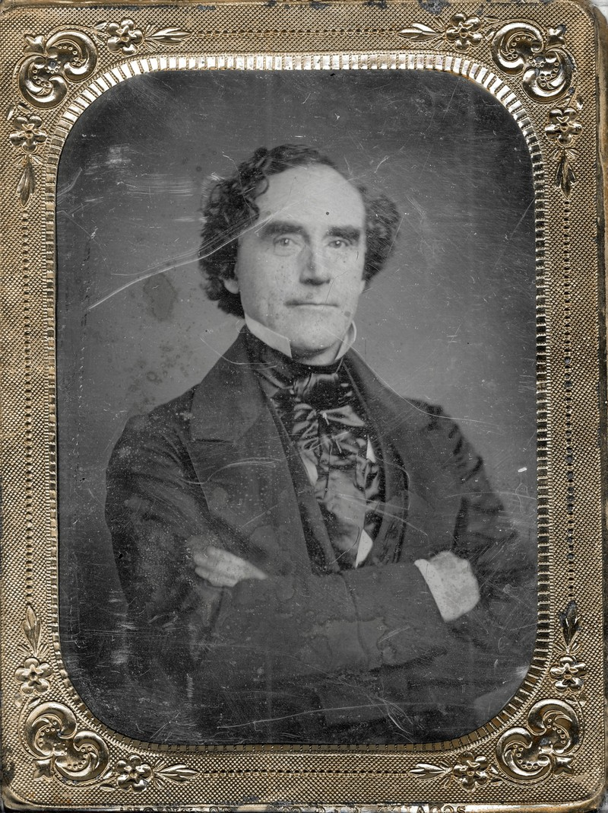
Meriwether Lewis
Meriwether Lewis
Born August 18, 1774
Lewis was a young army officer who went off on a expedition with William Clark to the pacific and to go to the Westward Expansion to explore and chart
After his journey he became the governor of Louisiana Territory.
His journey with William Clark was one of the most successful in American History.

Slide 20
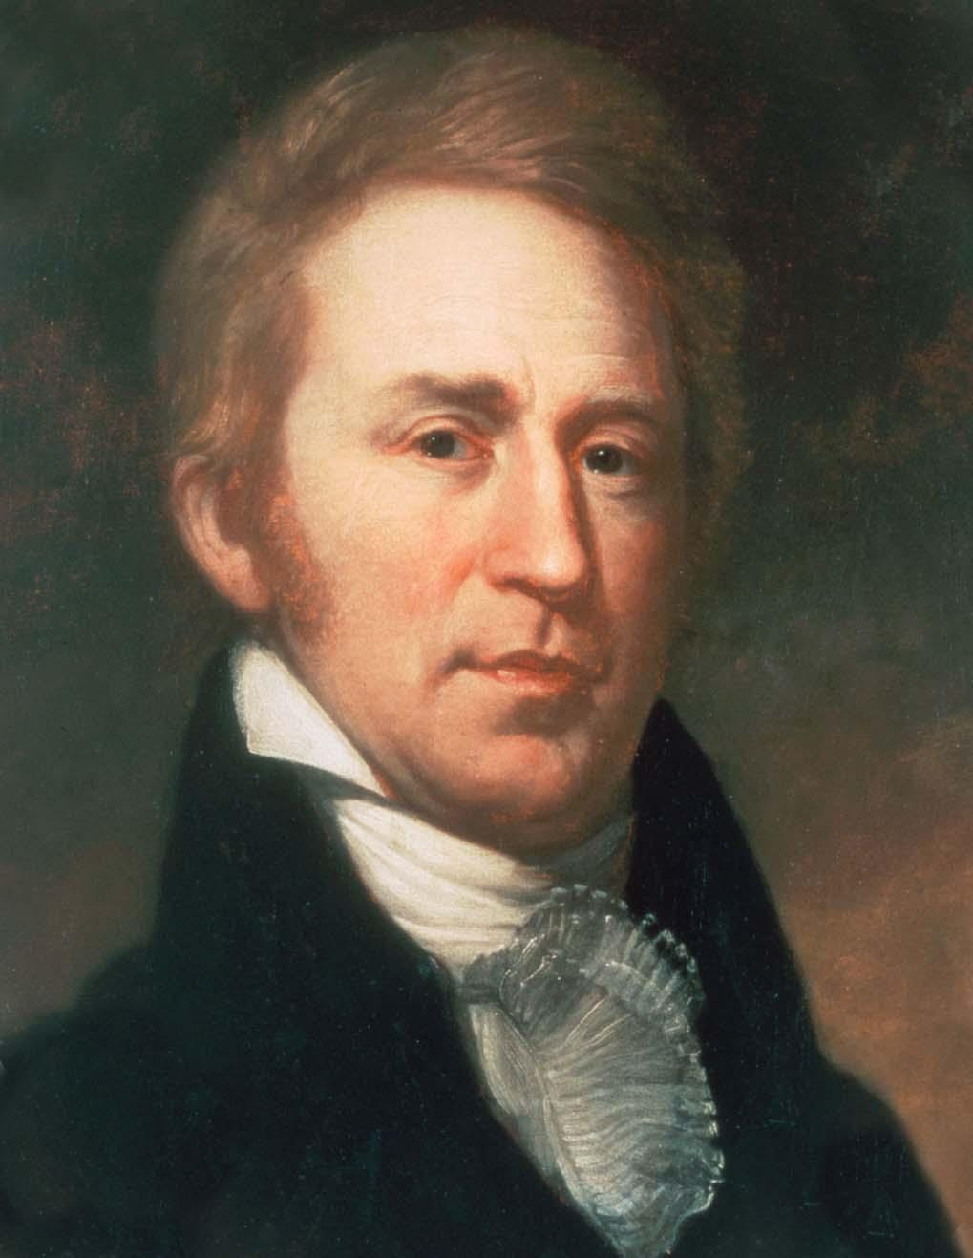
William Clark
William Clark
Born August 1, 1770
Clark was a military man who joined his friend who was sent by Thomas Jefferson to explore new land on the way to the pacific and the Westward Expansion.
Their expedition lasted from 1804-1806. It was said to have been one of the most successful journeys in American History.

Slide 21
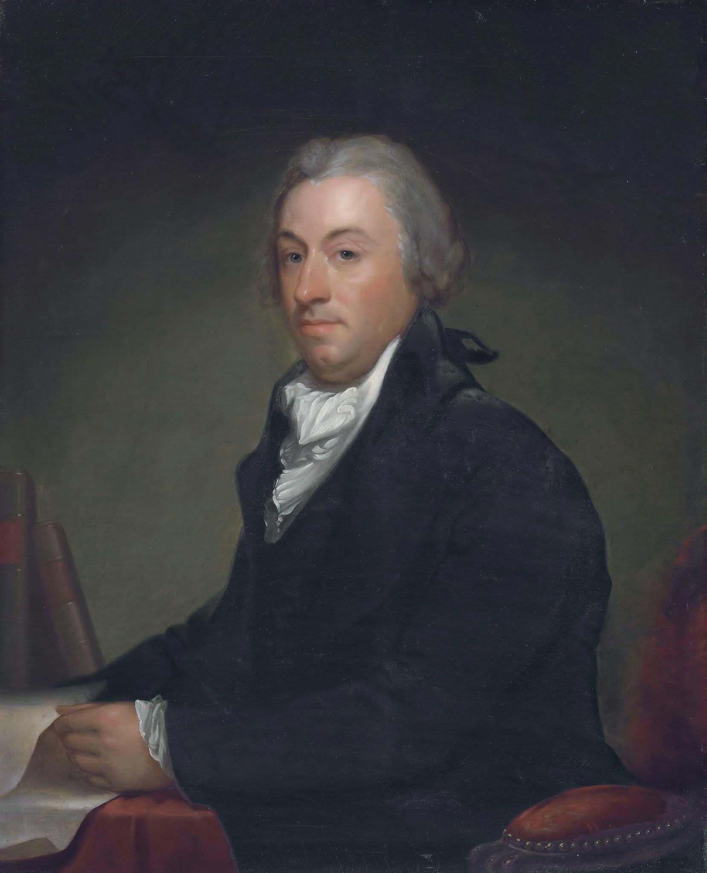
Robert Livingston
Robert Livingston
Born November 27, 1746
Livingston was part of the five-man committee to draft the Declaration of Independence in 1776,
He agreed to go with Jame Monroe to negotiate with Napoleon to purchase the Louisiana Territory.
Afterwards, he was also the ambassador to France in 1801.

Slide 22
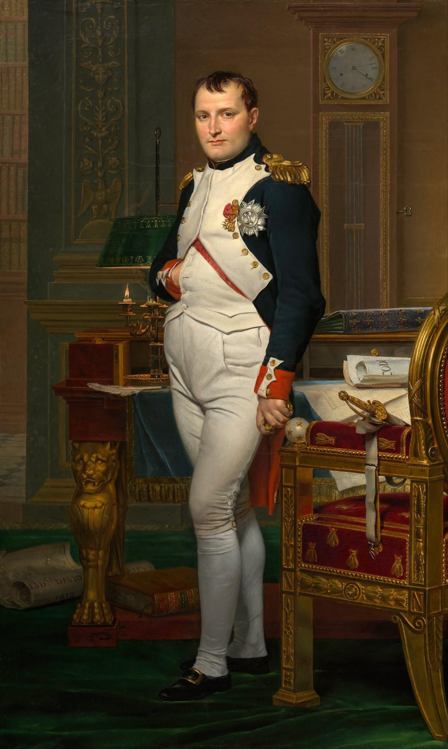
Napoleon Bonaparte
Napoleon Bonaparte
Born August 15, 1769
Napoleon was a French military officer who was trying to abolish a slave revolt in Haiti. As well as fighting a war with the British
When the slaves were destroying his army he needing funding and negotiated a price to sell the Louisiana Territory

Slide 23
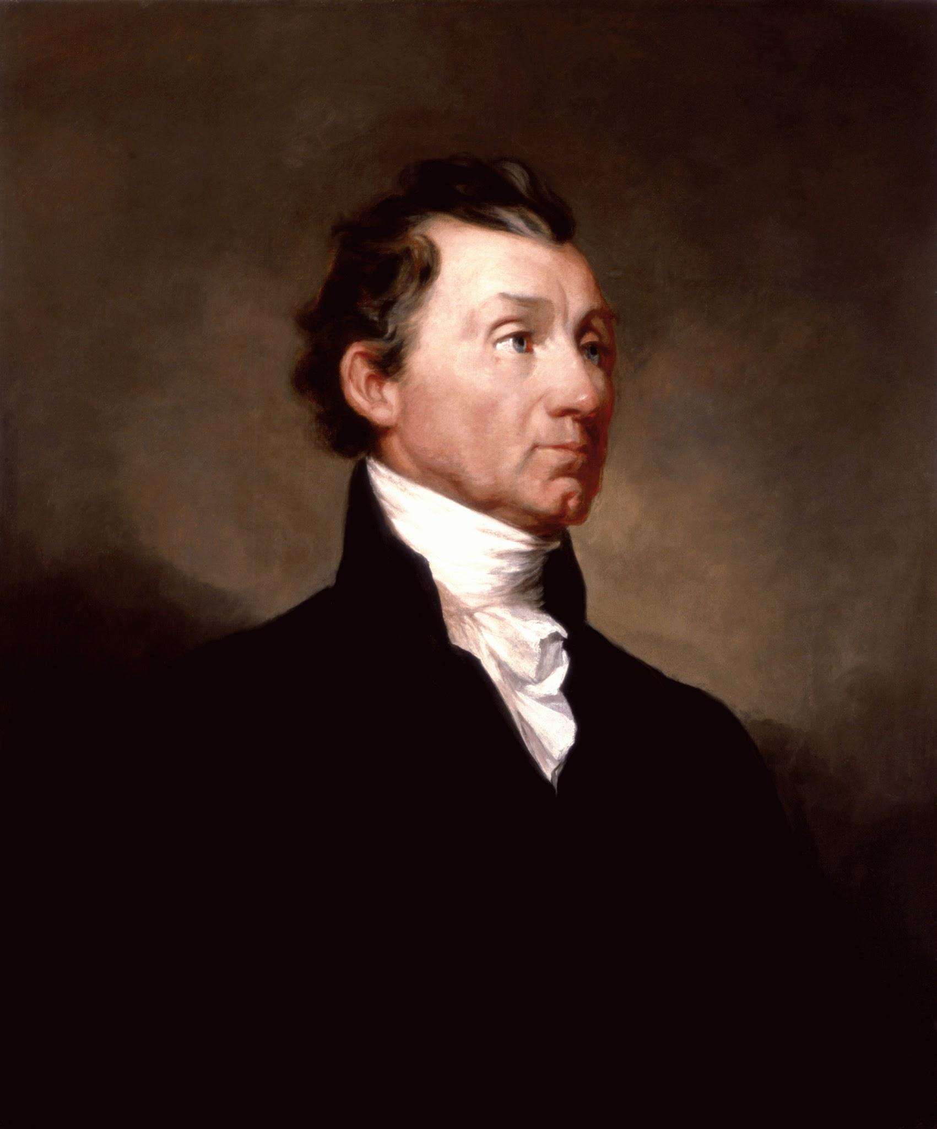
James Monroe
James Monroe
Born April 28, 1758
5th President of the United States
U.S. Ambassador to France and England
Governor of Virginia, Senator of Virginia and Minister of Britain
James Monroe in 1803 went on a mission with Robert Livingston to purchase the Louisiana Territory.
Negotiations were well on there way and Monroe and Livingston
signed a treaty and two conventions where France sold the Louisiana Territory to the U.S.

Slide 24
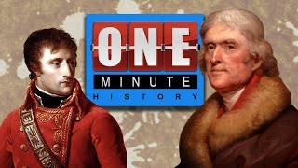
Video

Slide 25

Pop Quiz
How much did the Louisiana Purchase cost?
a. 15 million b. 340 million c. 11,250,000 million d. 3,750,000 million
What were the results of the Louisiana Purchase?
Are debt increased b. The nation doubled in size C. Rhys did a presentation also on this D. All of the above
3. Who were the people that went over to negotiate with Napoleon for the purchase of the Louisiana Territory? A. Milin and Rowland B. Matthew and Mr. C C. Jefferson and Napoleon D. James Monroe and Robert Livingston

Slide 26

You thought this was over wrong
4. What was Napoleon's last name?
Dynamite b. Bonaparte C. Livingston D. Lewis
5. What two pieces of land does Thomas Jefferson tell James Monroe and Robert Livingston to negotiate with Napoleon?
Massachusetts and Chicago b. West Florida c. b and d d. New Orleans Port
6. Who were all the important people in the Louisiana Purchase?
7. How many acres of land did the Louisiana Purchase consist of?

Slide 27
Questions?

Slide 28


Slide 29
Work Cited
Google Image from Background
“Thomas Jefferson & the Louisiana Purchase - One Minute History: Youtube”
https://www.youtube.com/watch?v=ODoq9rBOKQU Published: January 26, 2022 Accessed: January 22, 2024 Author: Estela Mercado
“Important people in the Louisiana Purchase. By Hannah Kuchenbrod on Prezi Next: Prezi” https://prezi.com/aftmon0hsint/important-people-in-the-louisiana-purchase/ Accessed: January 31, 2024 Author: Hannah Kuchenbrod
“Jefferson Buys Louisiana Territory, and the Nation Moves Westward: National Archives |” https://www.archives.gov/publications/prologue/2003/spring/louisiana-purchase.html Published: November 18, 2022 Accessed: January 31, 2024 Author: Wayne T De Cesar, Susan Page, and Richard Schneider Wikipedia Contributors.
“Louisiana Purchase.” Wikipedia, Wikimedia Foundation, 26 Jan. 2019, en.wikipedia.org/wiki/Louisiana_Purchase. Accessed: February 1, 2024
“Milestones: 1801–1829 - Office of the Historian: Milestones: 1801–1829 - Office of the Historian” https://history.state.gov/milestones/1801-1829/louisiana-purchase Accessed: February 1, 2024
“Secretary of the Treasury - Friendship Hill National Historic Site (U.S): National Park Service” https://www.nps.gov/frhi/learn/historyculture/secretaryofthetreasury.htm Published: October 25, 2021 Accessed: February 1, 2024
“Jefferson and the Louisiana Purchase: Thomas Jefferson's Monticello” https://www.monticello.org/thomas-jefferson/louisiana-lewis-clark/the-louisiana-purchase/ Accessed: February 1, 2024 Author: Paul Delaroche
“Louisiana Purchase - Definition, Facts & Importance | HISTORY”
https://www.history.com/topics/19th-century/louisiana-purchase Published: December 2, 2009 Accessed: February 1, 2024
“U.S. Senate: The Senate Approves for Ratification the Louisiana Purchase Treaty: Senate.gov”https://www.senate.gov/about/powers-procedures/treaties/senate-approves-louisiana-purchase-treaty.htm Accessed: February 1, 2024
“Louisiana Purchase Description and Map: Mr. Nussbaum”https://mrnussbaum.com/louisiana-purchase-description-and-map Accessed:February 1, 2024
“Louisiana Purchase, 1803. Florida Purchase, 1819: Library of Congress”
https://www.loc.gov/resource/g3701sm.gct00482/?sp=21 Accessed: February 1, 2024
Author: EWA Rowles
“Treaty of Oregon: Northwest Power and Conservation Council”
https://www.nwcouncil.org/reports/columbia-river-history/treatyoforegon/ Accessed: February 1, 2024
“Milestones: 1830–1860 - Office of the Historian: Milestones: 1830–1860 - Office of the Historian”https://history.state.gov/milestones/1830-1860/oregon-territory Accessed: February 1, 2024
“Oregon Territory: Wikipedia”
https://en.wikipedia.org/wiki/Oregon_Territory Accessed: February 1, 2024 Author: Alexander Mackenzie
“The Louisiana Purchase and its exploration (article): Khan Academy”
https://www.khanacademy.org/humanities/us-history/the-early-republic/politics-society-early-19th-c/a/the-louisiana-purchase Accessed: February 1, 2024 Author: Edgar Samuel Paxson
“Protesting the Louisiana Purchase: Teaching American History”
https://teachingamericanhistory.org/blog/protesting-the-louisiana-purchase/ Published: July 4, 2019 Accessed: February 1, 2024 Author: Ray Tyler
“What was a negative result of the Louisiana Purchase? Homework.Study.com”
https://homework.study.com/explanation/what-was-a-negative-result-of-the-louisiana-purchase.html#/:~:text=Answer%20and%20Explanation:,over%20the%20issue%20of%20slavery Accessed: February 1, 2024
“How did Lewis and Clark contribute to the westward expansion? Homework.Study.com”
https://homework.study.com/explanation/how-did-lewis-and-clark-contribute-to-the-westward-expansion.html Accessed: February 1, 2024
“The Louisiana Purchase Questions and Answers: eNotes”
https://www.enotes.com/topics/louisiana-purchase/questions
Accessed:February 1, 2024
“American Indians in Louisiana - Jean Lafitte National Historical Park and Preserve (U.S:National Park Service” https://www.nps.gov/jela/learn/historyculture/native-americans-in-louisiana.htm
Published: November 28, 2022 Accessed: February 1, 2024
“Louisiana Purchase Treaty (1803) | National Archives: National Archives |”
https://www.archives.gov/milestone-documents/louisiana-purchase-treaty
Published: May 10, 2022 Accessed: February 1, 2024
“The Louisiana Purchase was a bargain. But it came at a great human cost. National Geographic” https://www.nationalgeographic.com/history/article/louisiana-purchase-bargain-came-great-human-cost Published: April 30, 2020 Accessed: February 1, 2024 Author: Erin Blakemore

